Slide 1

Java + Mobile course by Enered

Slide 2
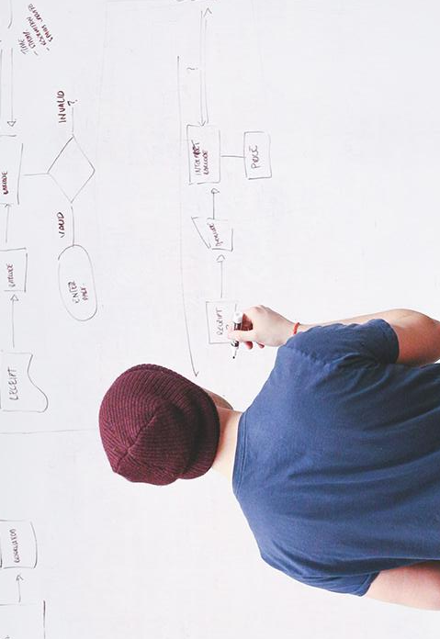
HELLO!
I am Vlad Butnaru
I will be your trainer for this Java session!
PS: It’ll be awesome!

Slide 3
What will we do today
Design patterns
What is static?
Encapsulation
Exceptions
Table relationships
Oracle Certification Induction
Memory and optimization

Slide 4
and
MULTITHREADING

Slide 5
1. Design patterns
SINGLETON – ex. Connection – only one instance per app run.
VISITOR – ex. A class that periodically checks a property of another class
STATE – ex. A property of a class
FAÇADE – ex. A class that instantiates other classes that implement an interface
FILTER – ex. Each method call, first calls the filter, then does the logic

Slide 6
2. Static … yet again!
Let’s say that the class Student has a static variable, called “numberOfInstances” that increment in the constructor.
That means, that, on EVERY instance of Student, we have the same number

Slide 7
3. Encapsulation
Actually, getters and setters :D

Slide 8
4. Exceptions
We have NULL POINTER EXCEPTIONS
We have FILE NOT FOUND EXCEPTIONS
We have INDEX OUT OF BOUNDS EXCEPTIONS
We have CUSTOM EXCEPTIONS

Slide 9
5. Table relations
One-to-many
Many-to-many
One-to-one

Slide 10
8. Multithreading
public class ScrapeThread implements Runnable{
@Override
public void run()
{}
}
And Thread.sleep() or Thread.wait()

Slide 11
7. Memory and optimization
Keep your code clean.
Keep your variables global.
Reuse as much code as you can.
Use STATIC when you can.
Assign NULL values to objects you no longer need.
Make it easy for garbage collector to do the dirty work.
Avoid Strings as much as possible.

Slide 12
6. Oracle Certification Induction
50 questions.
Multiple choice.
1 hour.
Once / 20 business days.
No Internet access.
No materials/mobile phones allowed.

Slide 13
THANKS!
Any questions?
You can find me at:
@web: http://vladbutnaru.com/
@facebook· Vladut Butnaru
@linkedin· Vlad Butnaru
@email : vlad2me@gmail.com
@phone : +40 0754 827 620

Slide 14
Feedback please!
http://bit.do/feedbackvlad

